Slide 1
Distributed FS Reliability
Demo 1
Akshay Katira, Sameer Sinha, Shilin Zhou, Srikar Yagavandla, Xinyi Chen

Slide 2
Background
Notes:
Background
Goals
Technology overview
Ansible
Terraform
MooseFS / DFS
Direction
Goal
Primary goal
Solution Architecture Overview
Work Done
Technology wise
Next Sprint

Slide 3
Distributed File Systems (DFS)
File system that is distributed on multiple file servers or multiple locations
Reliability and consensus critical to DFS
Notes:
Distributed File System (DFS) allows users of physically distributed systems to share their data and resources by using a Common File System.
Most of the data resides here , so the reliability of distributed file systems is critical.

Slide 4
Why Test Reliability of DFS ?
No standard frameworks for evaluating the reliability of distributed file systems and failure modes
Example node and network failures!
No Benchmark available for comparing two DFS

Slide 5
Our Direction

Slide 6
Goals of the Project
Automate configuration and infra setup
Develop Testing framework for targeted DFS
APIs for interacting with the framework

Slide 7
Solution Architecture Overview
OpenStack VMs
Cloud Provider
Terraform
Infrastructure management
Ansible
Automates installation & Configuration
Distributed File System
MooseFS
API Layer
Java Spring boot
Notes:
Will be discussed in further slides

Slide 8
Ansible
Open source IT engine
Automates application deployment
Cloud Provisioning
Idempotent
Notes:
Ansible is simple open source IT engine which automates application deployment, intra service orchestration, cloud provisioning and many other IT tools.
An idempotent operation is one that can be applied multiple times without changing the result beyond the initial application, such as multiplication by zero. Ansible modules are idempotent.
It will be best suited for configuration management.

Slide 9
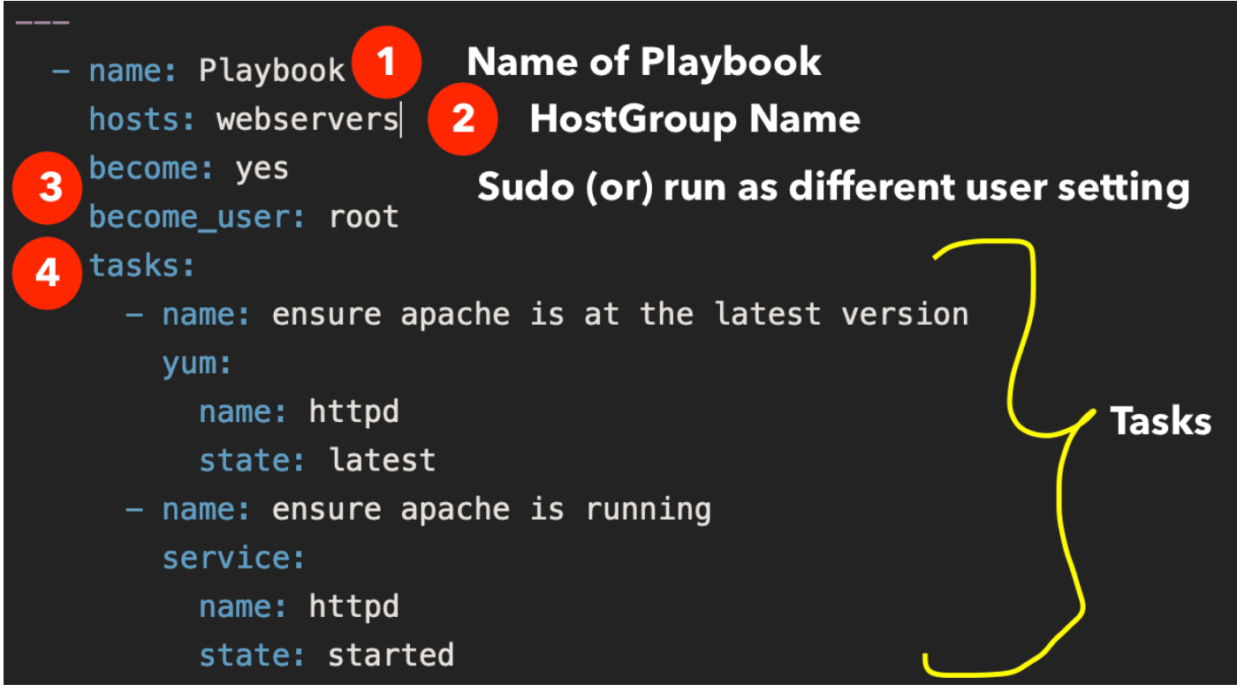
Notes:
Playbooks contain the steps which the user wants to execute on a particular machine. Playbooks are run sequentially. Playbooks are the building blocks for all the use cases of Ansible.
The Ansible inventory file defines the hosts and groups of hosts upon which commands, modules, and tasks in a playbook operate.
YAML

Slide 10
Terraform
Terraform is a tool for building, changing, and versioning infrastructure safely and efficiently.
Terraform can manage existing and popular service providers as well as custom in-house solutions.
For Example Open Stack, AWS etc.
Notes:
Its kind of defining what instances you need, in which networks, whom do you want to provision it for
The role in the project is for setting up the initial infrastructure of VMs, which may be EC2 instances and than interactively use it to mimic failure scenarios
So far we were spending hours learning more about it and experimenting on the AWS and the MOC openstack instances
The Workflow as who comes first Ansible or Terraform is yet to be determinsed

Slide 11
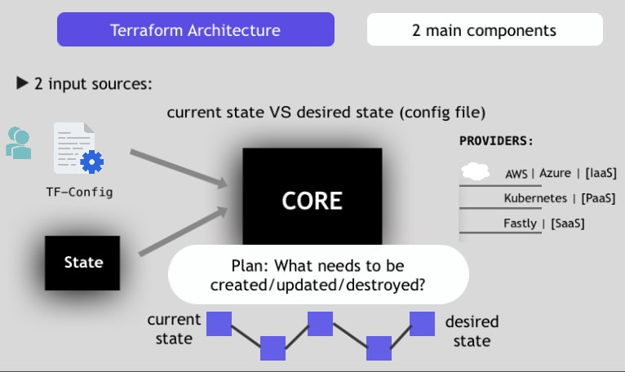

Slide 12
MooseFS
MooseFS is a Fault-tolerant, Highly available, Highly performing, Scaling-out, Network distributed file system.
High reliability (several copies of the data can be stored on separate physical machines)
Capacity is dynamically expandable by adding new computers/disks.

Slide 13
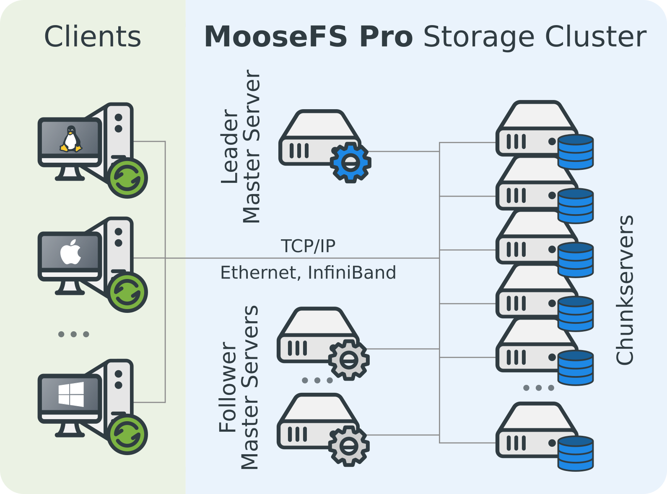
MooseFS
Components:
Managing servers (master servers)
– management machine of the whole filesystem, storing metadata for every file.
Metadata backup server(s) (metalogger server)
– store metadata changelogs and periodically download main metadata file.
Data servers (chunk servers)
– commodity servers storing files’ data and synchronizing it among themselves (supports replication).
Client computers
– access (mount) the files in MooseFS

Slide 14
Work Done this Sprint

Slide 15
Setting Up Environment
Setting up MOC VMs on OpenStack
Install Ansible on Management VM
Install Terraform on Management VM
Install MooseFS manually on Cluster VMs

Slide 16
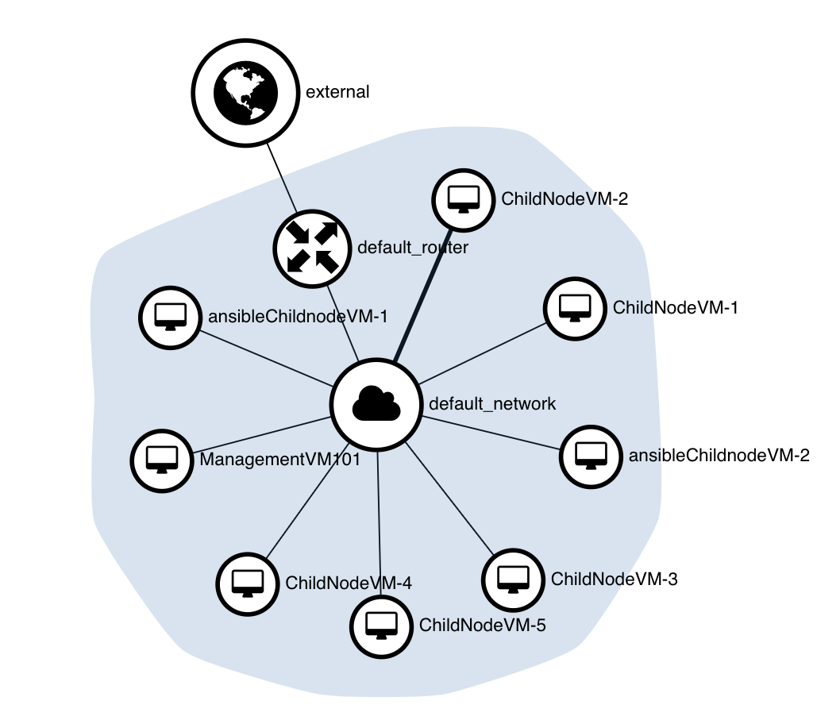
Setting Up Private Network

Slide 17
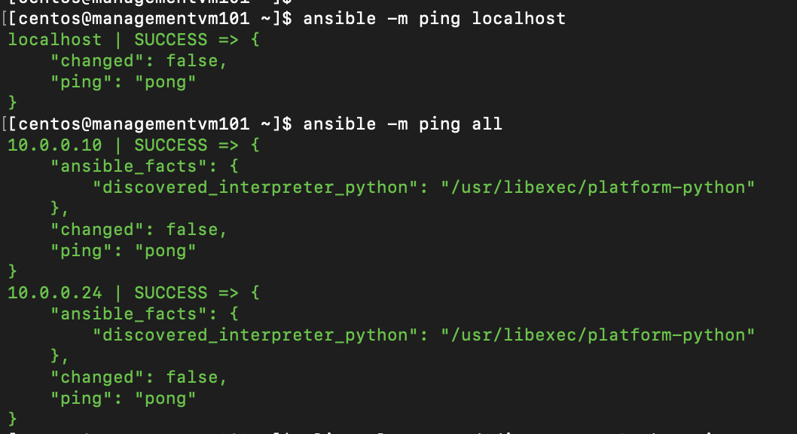
Setting Up Ansible Connection

Slide 18
Setting Up MooseFS Environment
Setup Virtual Machine
Create image
Create instances
Working on Ubuntu Environment
Connect local machine with OpenStack Management VM
Connect local machine with moosefs servers

Slide 19
Setting Up MooseFS
(On local VMs) Set up DNS server for the VMs
Install MooseFS for the VMs from the repository
Install Servers:
Master Server w/ CGI monitor Interface
Metalogger
Chunk Servers w/ additional storage volume
Client Server
Notes:
For the set up for MooseFS,
We set it up separately on local VMs and OpenStack MOC.
We followed the steps of creating the VMs, configure the network, installing MooseFS on each of the servers, and set up different servers separately.
We set up the …
and the client server connecting to the master server, which can check the status of the MooseFS system

Slide 20
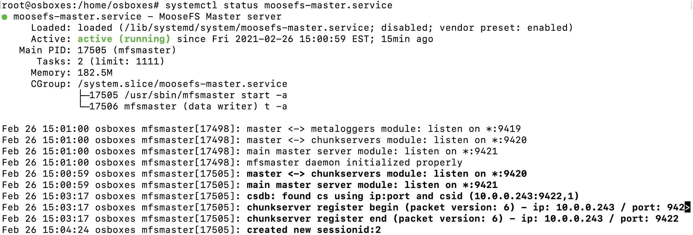
Setting Up MooseFS
Master Server Running message
Notes:
This is the status of the master server after successfully connecting to the metaloggers and chunkservers

Slide 21
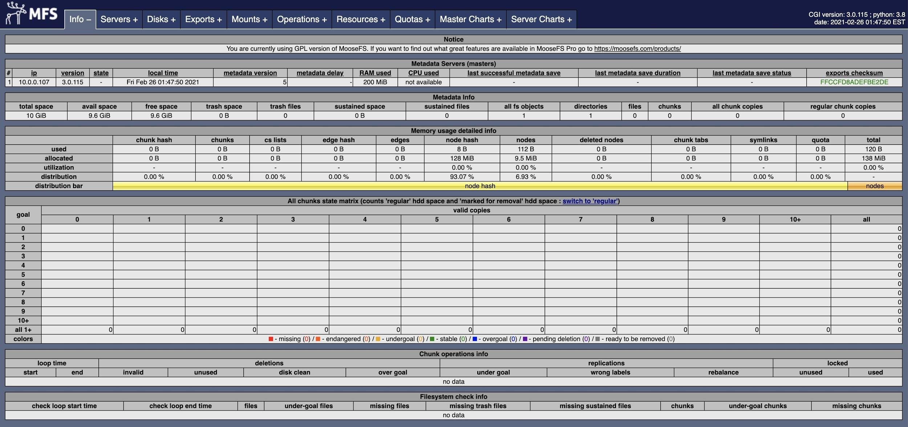
Setting Up MooseFS
CGI Monitor Interface
Notes:
This is the CGI Monitor interface connected with the master server. here, we can easily check the status of the chunk servers

Slide 22
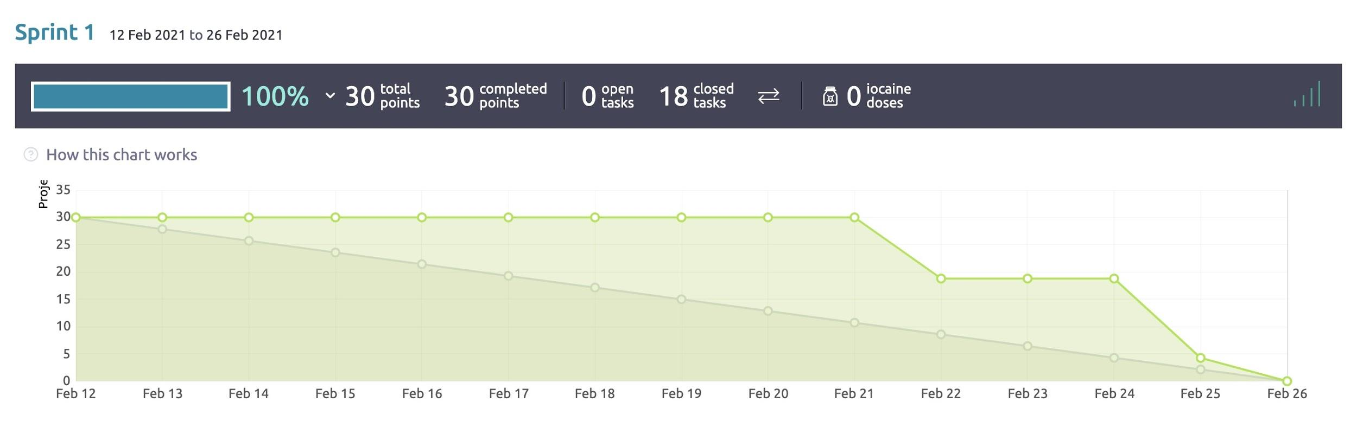
Sprint 1 Burndown Chart
Notes:
This is our Burndown Chart for sprint 1, Since we got the access to the OpenStack a bit late, we started to close the tasks late, but we quickly finished the tasks within the time frame.

Slide 23
Next Sprint
Automate MooseFS installation using Ansible
Integrate Terraform & Ansible
Design testing framework APIs

Slide 24
Questions from the Audience

